Slide 1
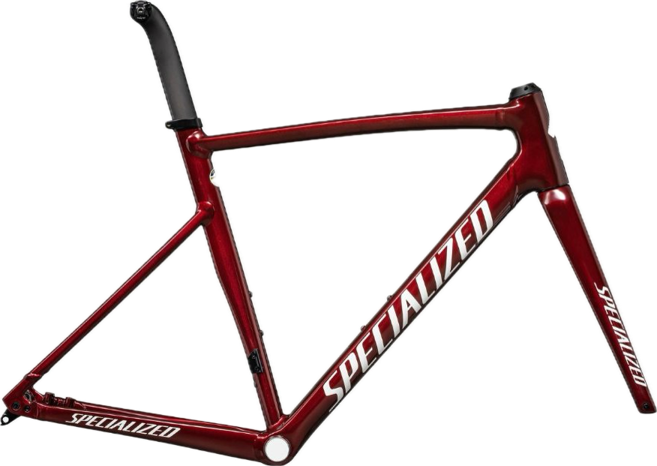
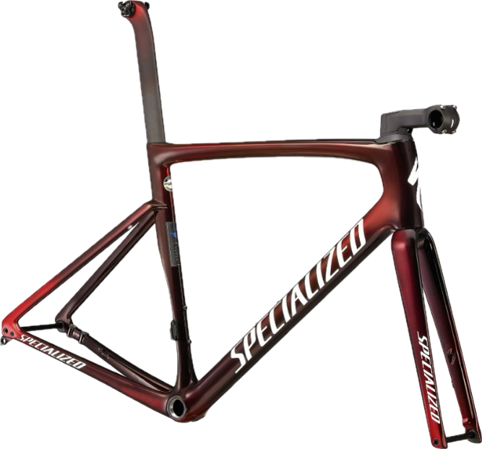
Comparative Life Cycle Assessment of Aluminium and Carbon Fiber Bike Frames
Lazy Caffeine Addicts:
Aanand Nataraj Satheesh Manimala
Alessandro Gorla
Áron Zsombor Sebó
Malte Pelle Rietdorf

Slide 2

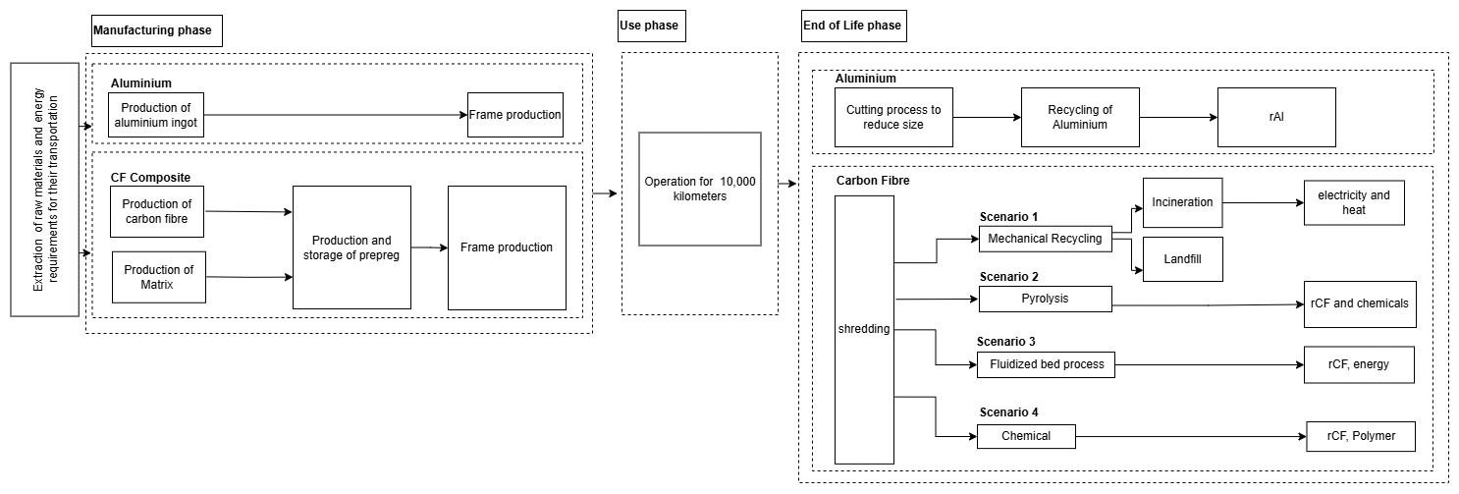
Background and Methodology
Lazy Caffeine Addicts
Goal: Find frame with least amount of environmental impact
Comparison of Energy usage and CO2 emissions
Data: from Reports, and Tools (Gabi…)
System boundaries:
Specialized-Allez Sprint​ | Specialized-Tarmac SL7​
Aluminum​ | Carbon Fiber​
2.35kg​ | 0.8kg​
Notes:
1-2 min
Motivation and Goal
System boundary
Data collection: what (Energy usage and CO2 emissions) and how (reports, tools (Gabi,…)

Slide 3

LCA of Aluminium Bike Frame
Lazy Caffeine Addicts
Raw-Material Extraction phase
Manufacturing phase
Recycling Phase
Frames are cut to reduce size for easy handling for recycling, this energy is considered.
Transportation is ignored due to high complexity of logistics.
Considerations
Total Wastage from Manufacturing operations is considered as 10% of the input material for producing one bike
Weight of the end product- 2.35 Kg. Input material considering wastage- 2.6 Kg
Total number of Miter cuts after hydroforming tubes = 16 for each bike frame
Total number of Welded joints = 11 for each frame
Average tube diameter= 50 mm total weld length=1.7 m
Considerations:
Bike frame made with Virgin Aluminium
Aluminium Ingots are produced in China and transported to Europe through ocean(13000 kms)
Transportation from the shipyard to the factory in Germany is also modelled through rail transportation (630 kms)
 | Energy Consumption​ | CO2 Emissions
Cutting | ​0.04 MJ / Cut | Yet to collect / Data unavailable
Recycling | 34 MJ/Kg | Yet to collect / Data unavailable
 | Energy Consumption​ | CO2 Emissions
Extrusion | ​7.36 MJ/Kg | 6.57 kg CO2 eq / ton
Tube Hydroforming | 75.6 MJ/Kg | Yet to collect / data unavailable
Miter Cuts | 178.5 KJ/Cut | 0.0426 Kg CO2 eq / cut
TIG Weld | 38.3 MJ/metre | 2.44 Kg CO2 eq/ metre
T6 Heat treatment | Yet to collect / Data unavailable
Painting | ~10 MJ / bike |  | ~5 kgCO2 / bike
Aluminium | Energy Consumption​ | CO2 Emissions
Raw Material Extraction | ​157207 MJ/ton | 15947 kg CO2 eq / ton
Transportation | 0.209 MJ/ton/km | 32.8 CO2 eq/km/ton
CO2 eq emission displaced by recycling aluminum will be considered.
Notes:
as bikes may travel varying distances based on local recycling infrastructures, collection methods, and market demands for recycled materials

Slide 4
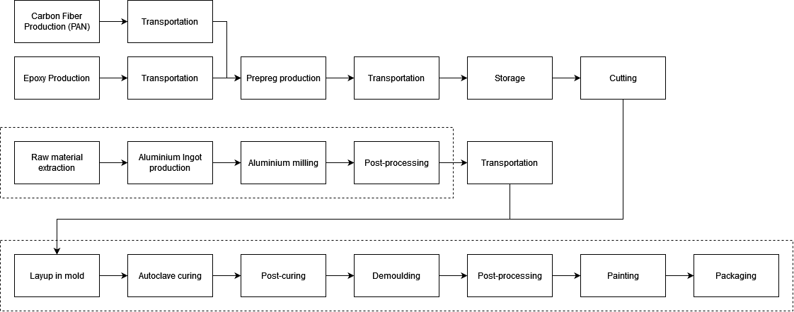
LCA of Carbon Fiber
Lazy Caffeine Addicts
Frame made from CF prepreg
Mold made out of 100% recycled aluminium
Frame sold separately, not assembled in factory
Calculated with manufacturing losses (prepreg cutting, postprocessing, painting)
Transport by rail and ferry, same as before
Production locations based on real suppliers
Process | Location
Resin, Fiber | Japan
Prepreg production | Japan
Paint | China
Recycled Aluminium | China
Frame production | Taiwan
Postprocessing, painting | Taiwan
Warehouse | Netherlands
Carbon fiber | Energy Consumption​ (MJ/bike) | CO2 Emissions (kgCO2 eq/bike)
Raw Materials | ​550.94 | 74.29
Frame Production | 46.75 | 6.53
Transportation(s) | 2.07 | 209.53
End of Life (average of multiple scenarios) | 12.00 | 1.47
Total: | 611.77 | 291.83
Notes:
Max. 3 minutes!
Flowchart production
Flowchart transportation
Table with Energy consumption and CO2 emissions
Different EoL recycling methods

Slide 5
Next Steps to Finish the Report?
Lazy Caffeine Addicts
Collect missing data and finish calculations
1
Aluminium: compare both scenarios (virgin and recycled Al)
2
Carbon Fiber: Compare recycling methods
3
Compare both materials
4
Final Discussion
5
Notes:
1-2 minutes

